Slide 1
CHAPTER 2
ATOMIC STRUCTURE AND INTERATOMIC BONDING
Chapter Outline
Review of Atomic Structure
Electrons, Protons, Neutrons, Quantum mechanics of atoms, Electron states, The Periodic Table
Atomic Bonding in Solids
Bonding Energies and Forces
Periodic Table
Primary Interatomic Bonds
Ionic
Covalent
Metallic
Secondary Bonding (Van der Waals)
Three types of Dipole Bonds
Molecules and Molecular Solids

Slide 2
Atomic Structure
Atoms = nucleus (protons and neutrons) + electrons
Charges:
Electrons (-); protons(+) ----1.6 × 10⁻¹⁹ Coulombs
Neutrons are electrically neutral.
Masses:
Protons and Neutrons ~1.67 × 10⁻²⁷ kg.
Electron ~ 9.11 × 10⁻³¹ kg
Atomic mass = # protons + # neutrons
Atomic number (Z) = # protons
→chemical identification of element
Isotope number → # neutrons

Slide 3
Atomic mass units. Atomic weight.
Atomic mass unit (amu)
1 amu = 1/12 of mass of most common isotope of C
6 protons (Z=6) and six neutrons (N=6).
The atomic mass of ¹²C atom is 12 amu.
Atomic weight: A
Weighted average of atomic masses of naturally occurring isotopes.
Atomic weight of carbon is 12.011 amu.
Atomic weight is often in mass per mole.

Slide 4
A mole
Amount of matter with mass in grams equal to the
atomic mass in amu
(A mole of carbon has a mass of 12 grams).
One Mole contains Avogadro’s number of atoms,
N_{av} = 6.023 × 10²³.
N_{av} = 1 gram/1 amu.
Example:
Atomic weight of iron = 55.85 amu/atom = 55.85 g/mol

Slide 5
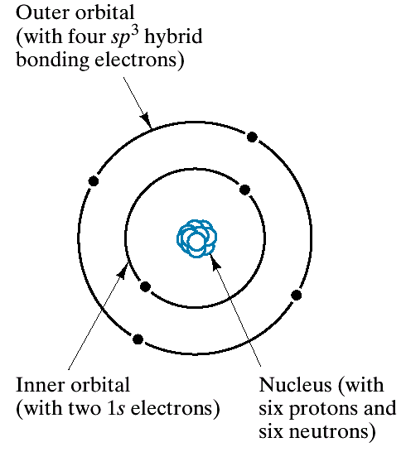
Atomic Structure

Slide 6
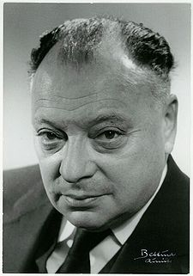
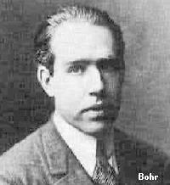
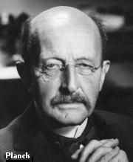
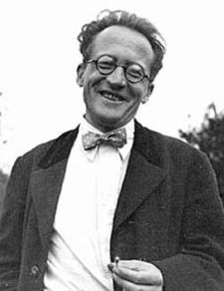
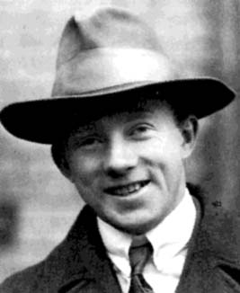
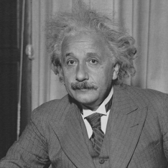

Slide 7
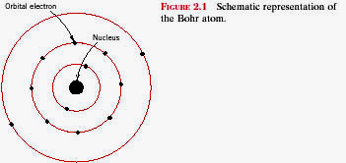
Electrons in Atoms
Electrons form a cloud around the nucleus
Radius ~ 0.05 – 1nm.
Picture looks like a mini planetary system. But Quantum Mechanics says this analogy is not correct

Slide 8
Electronic Structure
Electrons have wavelike and particulate properties.
  This means that electrons are in orbitals defined by a probability.
  Each orbital at discrete energy level determined by quantum numbers.
  Quantum # Designation
  n = principal (energy level-shell) K, L, M, N, O (1, 2, 3, etc.)
  l = subsidiary (orbitals) s, p, d, f (0, 1, 2, 3,…, n -1)
  m_{l} = magnetic 1, 3, 5, 7 (-l to +l)
  m_{s} = spin ½, -½

Slide 9
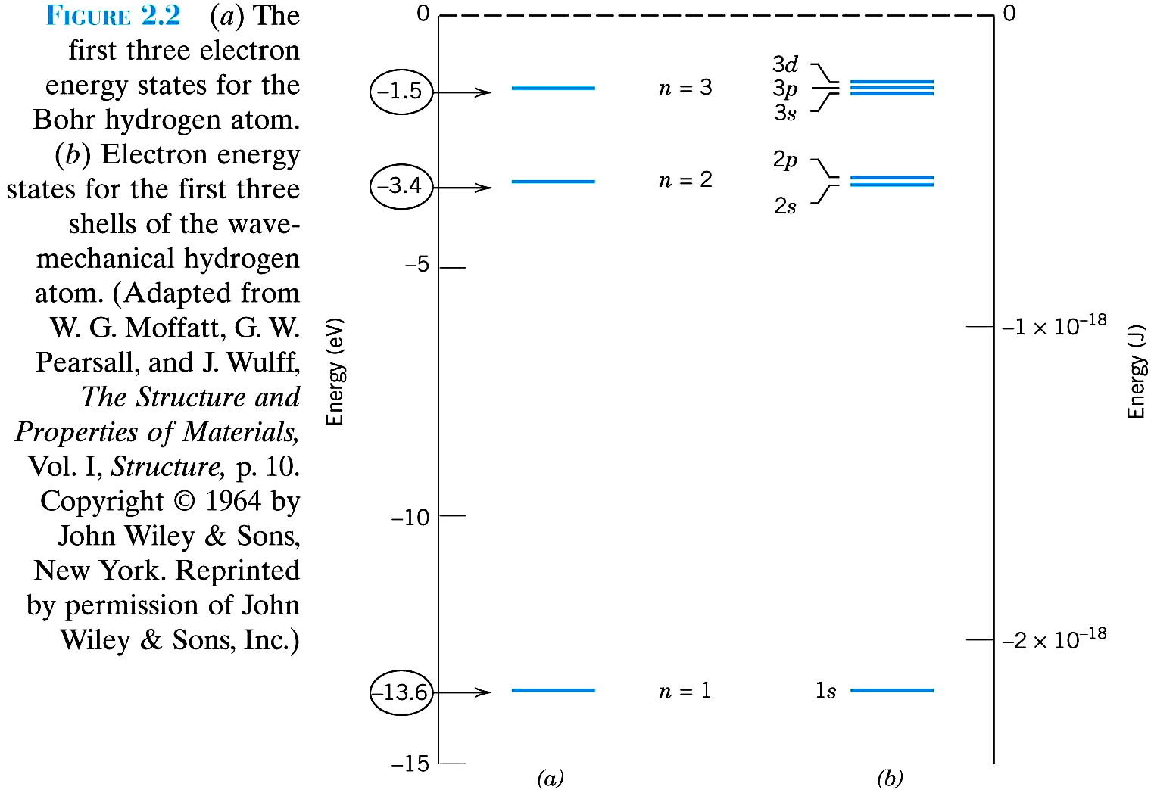

Slide 10
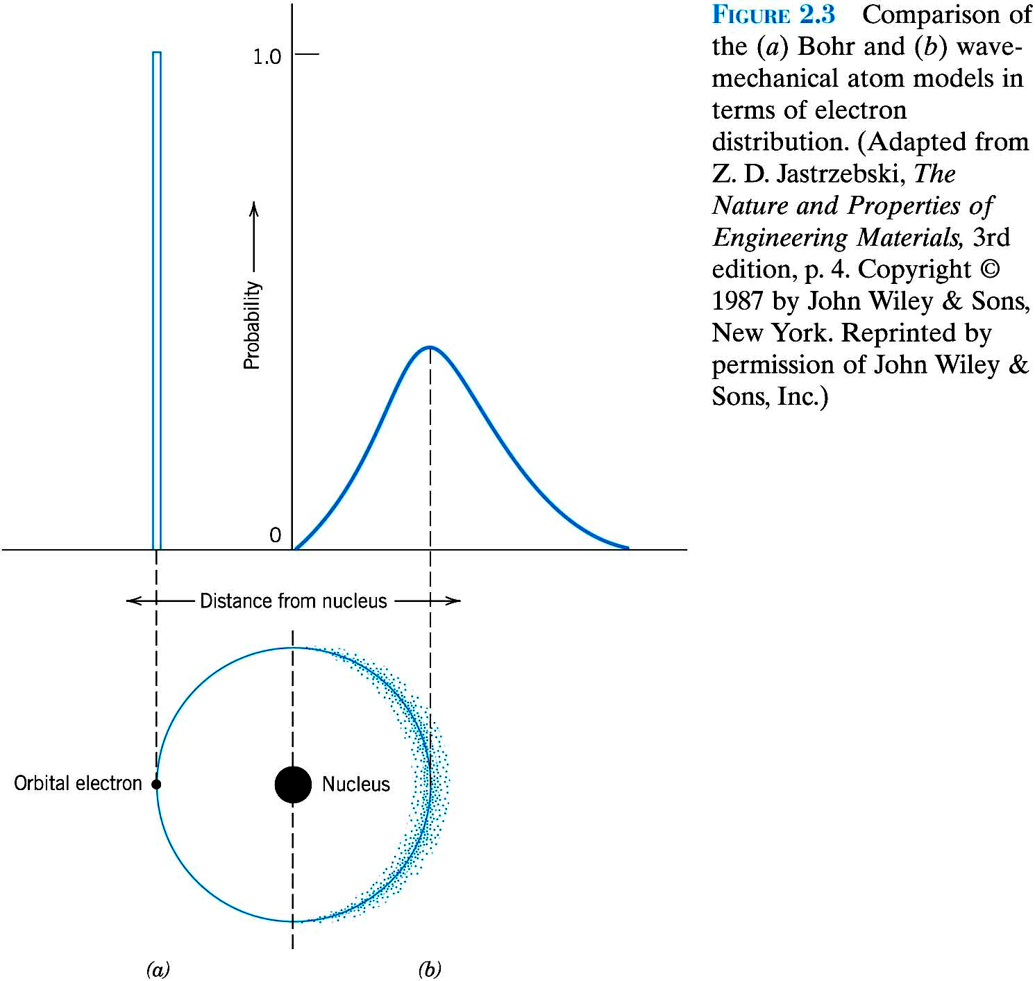

Slide 11
Electrons “orbits” are 'fuzzy‘
Can only discuss probability of finding it at some distance from the nucleus.
Only certain “orbits” or shells are allowed.
Shells identified by principal quantum number n,
n related to size of radius (and energy)
n = 1, smallest; n = 2, 3 .. are larger.
Second quantum number l, defines subshells.
Two more quantum numbers characterize states within subshells.

Slide 12
Electrons in Atoms
Quantum Numbers came from solution of Schrodinger’s equation
Pauli Exclusion Principle: only one electron can have a given set of the four quantum numbers.

Slide 13
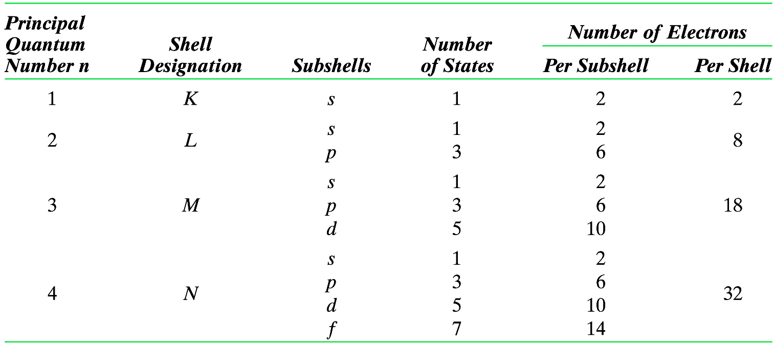
The Number of Available Electron States in Some of the Electron Shells and Subshells

Slide 14
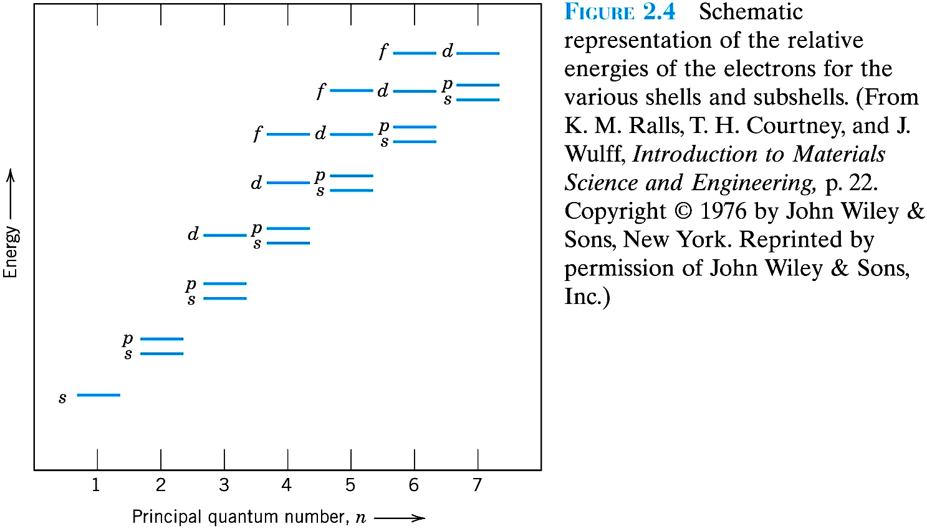

Slide 15
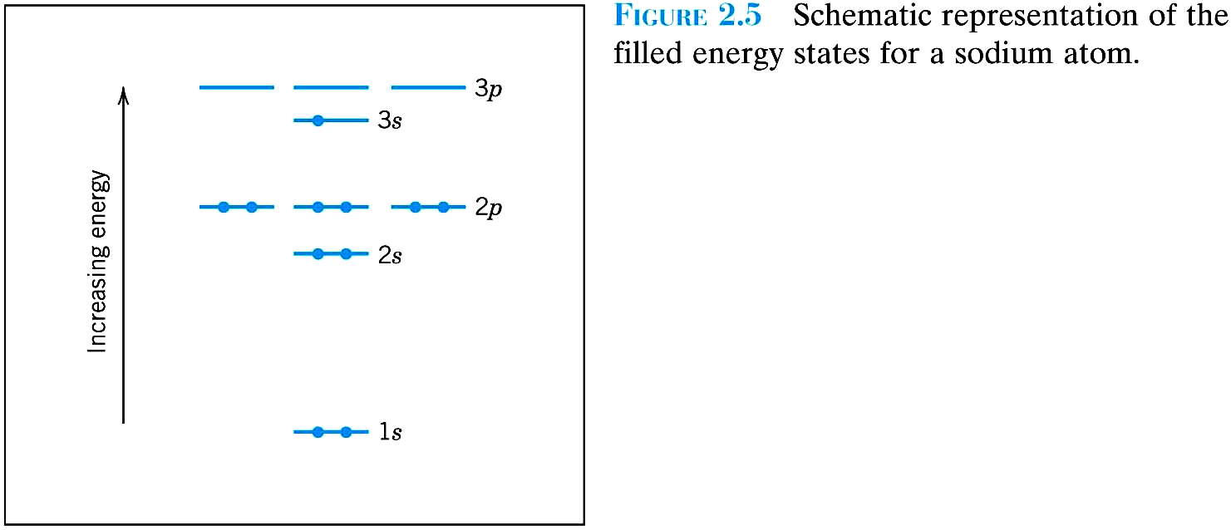

Slide 16
Li（3）：1s²2s¹
Na（11）：1s²2s²2p⁶3s¹
K（19）：1s²2s²2p⁶3s²3p⁶4s¹
Sc（21）：1s²2s²2p⁶3s²3p⁶3d¹4s²
Zn（30）：1s²2s²2p⁶3s²3p⁶3d¹⁰4s²
Kr（36）：1s²2s²2p⁶3s²3p⁶3d¹⁰4s²4p⁶

Slide 17
Electrons fill levels in order of increasing energy (only n,  make a significant difference).
Example:
Iron, Z = 26: 1s²2s²2p⁶3s²3p⁶3d⁶4s²
Outermost shell –
the valence electrons responsible for bonding.

Slide 18
• Most elements: Electron configuration not stable.
Element
Atomic #
Electron configuration
Hydrogen
1
1s
1
Helium
2
1s
2
(stable)
Lithium
3
1s
2
2s
1
Beryllium
4
1s
2
2s
2
Boron
5
1s
2
2s
2
2p
1
Carbon
6
1s
2
2s
2
2p
2
...
...
Neon
10
1s
2
2s
2
2p
6
(stable)
Sodium
11
1s
2
2s
2
2p
6
3s
1
Magnesium
12
1s
2
2s
2
2p
6
3s
2
Aluminum
13
1s
2
2s
2
2p
6
3s
2
3p
1
...
...
Argon
18
1s
2
2s
2
2p
6
3s
2
3p
6
(stable)
...
...
...
Krypton
36
1s
2
2s
2
2p
6
3s
2
3p
6
3d
10
4s
2
4p
6
(stable)

Slide 19
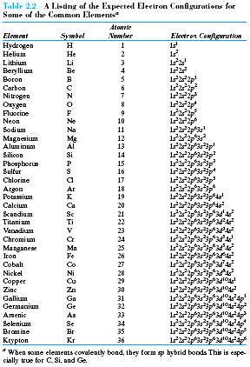
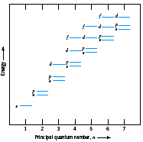

Slide 20
Valence electrons – those in unfilled shells
Filled shells more stable
Valence electrons are most available for bonding and tend to control the chemical properties
  example: C (atomic number = 6)
    1s² 2s² 2p²
valence electrons

Slide 21
Electronic Configurations
26
1s² 2s² 2p⁶ 3s² 3p⁶
3d ⁶ 4s²
ex: Fe - atomic # =
4d
4p
N-shell n = 4
valence
electrons
3d
4s
Energy
3p
M-shell n = 3
3s
2p
L-shell n = 2
2s
1s
K-shell n = 1

Slide 22
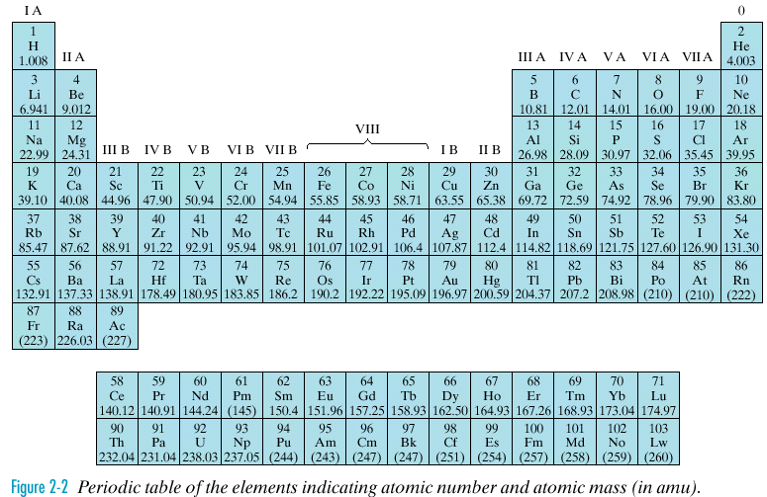
Periodic Table
Elements in same column share similar properties.
Group number → number of electrons available for bonding
0: Inert gases (He, Ne, Ar...) filled subshells: chem. inactive
IA: Alkali metals (Li, Na, K…) one electron in outer shell eager to give up electron – chem. active
VIIA: Halogens (F, Br, Cl...) missing one electron in outer shell - want to gain electron - chem. active

Slide 23
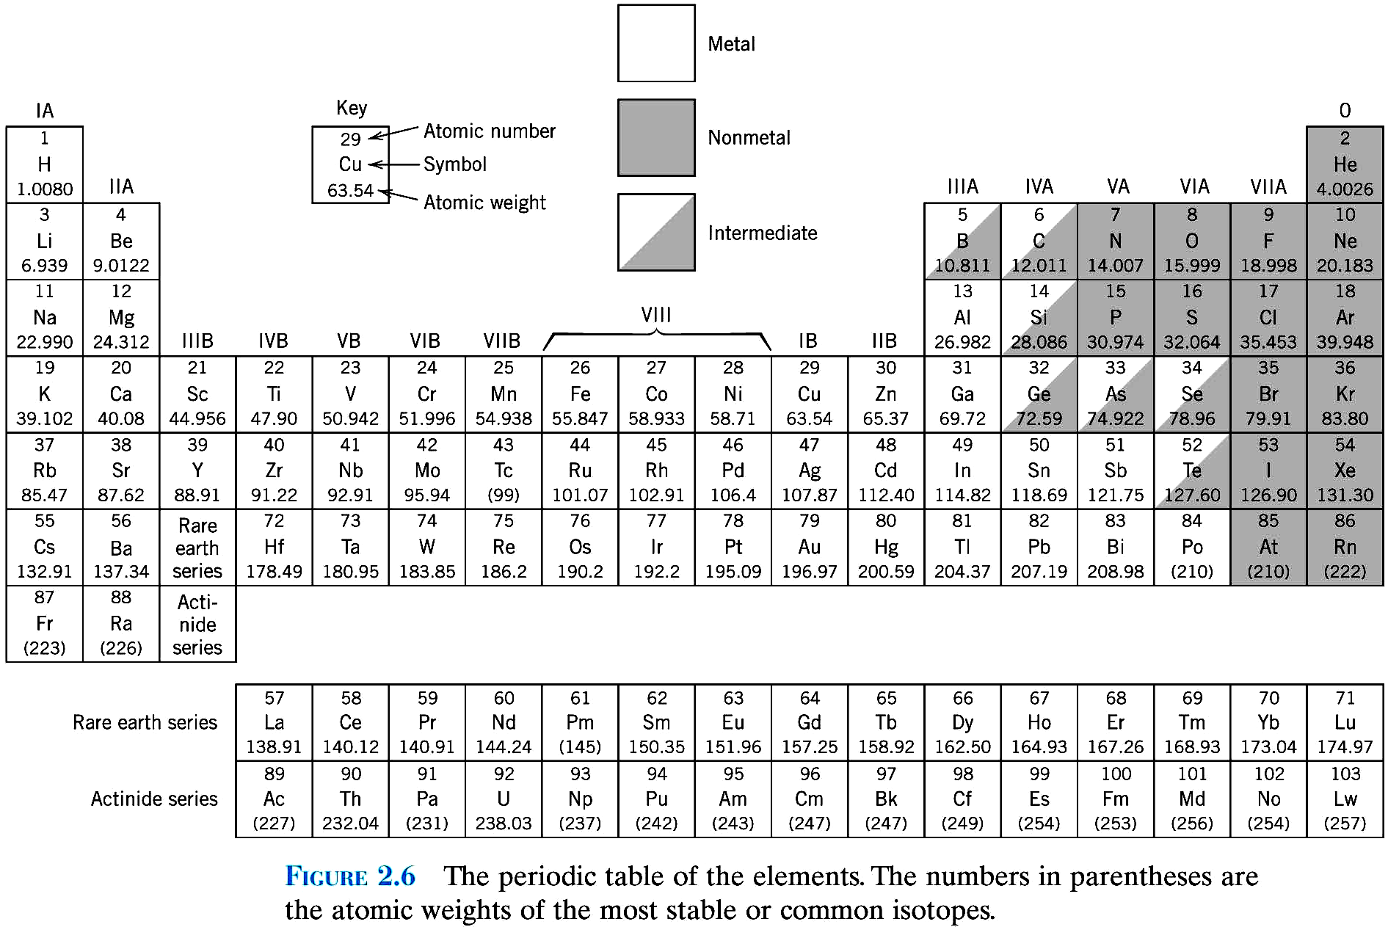

Slide 24
Electronegativity –
how willing atoms are to accept electrons.
Subshells with one electron –
low electronegativity
Subshells with one missing electron –
high electronegativity
Electronegativity increases from left to right
Metals are electropositive –
can give up their few valence electrons to
become positively charged ions

Slide 25
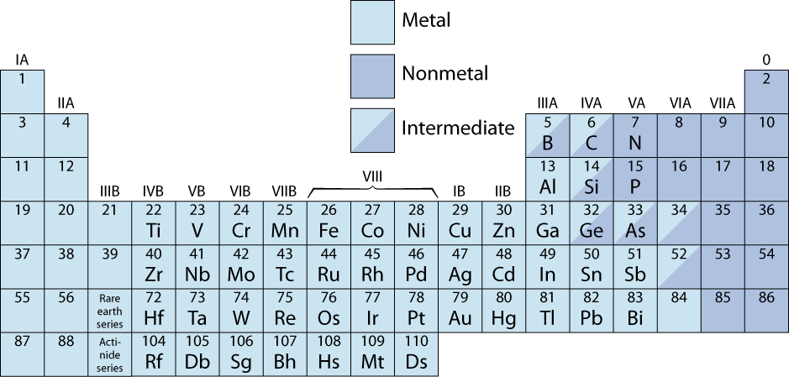
The Periodic Table
• Columns: Similar Valence Structure
give up 1e
inert gases
give up 2e
accept 2e
accept 1e
give up 3e
H
He
Li
Be
O
F
Ne
Na
Mg
S
Cl
Ar
K
Ca
Sc
Se
Br
Kr
Rb
Sr
Y
Te
I
Xe
Cs
Ba
Po
At
Rn
Fr
Ra
Electropositive elements:
Readily give up electrons
to become + ions.
Electronegative elements:
Readily acquire electrons
to become - ions.

Slide 26
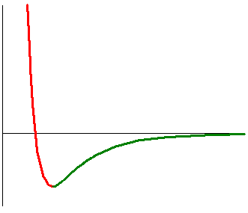
Bonding Energies and Forces
repulsion
Potential Energy, E
0
attraction
equilibrium
Typical potential between two atoms
Repulsion when they are brought close together
Related to Pauli principle
(As electron clouds overlap energy increases)
Attractive part: at large distances
(Depends on type of bonding)

Slide 27
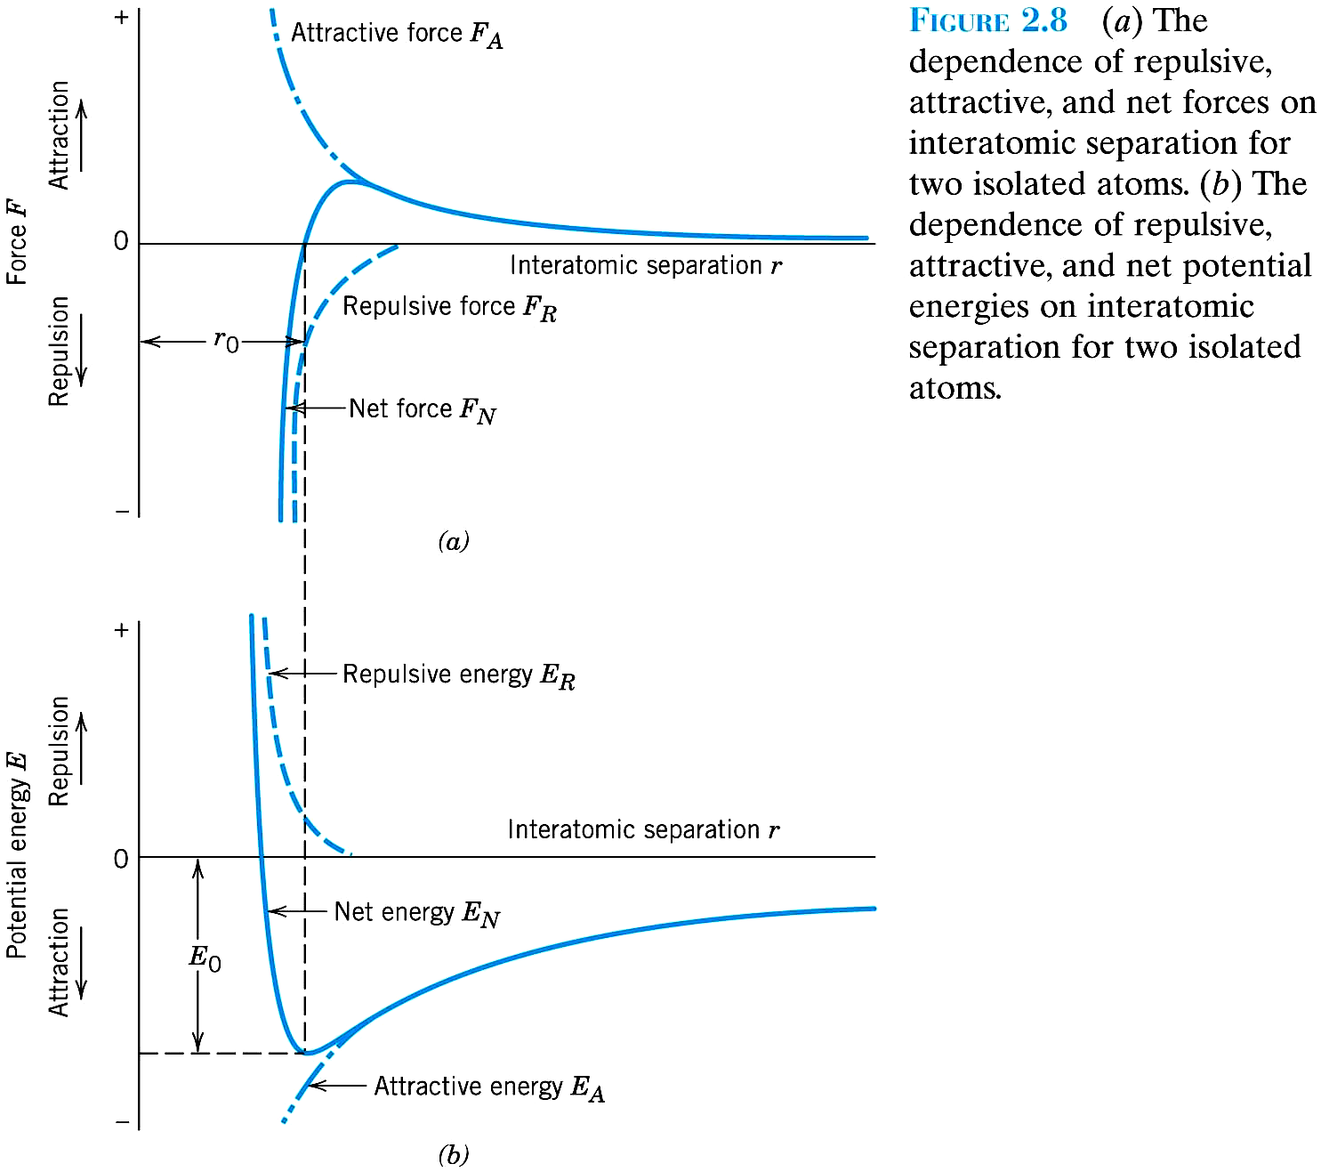
Bonding Energies and Forces
E₀ – bond energy
F= dE/dr
r₀ –equilibrium distance
at r₀, dE/dr = 0, → F_{a} = F_{r}

Slide 28
The electron volt (eV)
Energy unit convenient for atomic bonding
Electron volt –
energy lost / gained when an electron is taken through a potential difference of one volt.
E = q × V
For q = 1.6 x 10⁻¹⁹ Coulombs
V = 1 volt
1 eV = 1.6 x 10⁻¹⁹ J

Slide 29
Types of Bonding
Primary Bonding: e⁻ are transferred or shared
Strong (100-1000 KJ/mol or 1-10 eV/atom)
Ionic:
Example - Na⁺Cl⁻
Strong Coulomb interaction between a positive atom
(lost an electron, Na⁺) and a negative atom (an extra electron, Cl⁻)
Covalent: electrons shared between the atoms.
Example - H₂
Metallic:
Atoms lose some electrons from valence band
Those electrons are shared by all the material
Secondary Bonding: no e⁻ transferred or shared
Interaction of atomic/molecular dipoles
Weak (< 100 KJ/mol or < 1 eV/atom)
Fluctuating Induced Dipole (inert gases, H₂, Cl₂…)
Permanent dipoles (polar molecules - H₂O, HCl...)

Slide 30
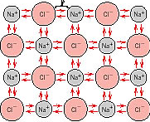
Ionic Bonding
Mutual ionization by electron transfer
(remember electronegativity table)
Anion = negatively charged atom
Cation = positively charged atom
Ions are attracted by strong coulombic interaction
Oppositely charged atoms attract
An ionic bond is non-directional

Slide 31
Ionic Bonding
• Occurs between + and - ions.
• Requires electron transfer.
• Large difference in electronegativity required.
• Example: NaCl
Na (metal)
Cl (nonmetal)
unstable
unstable
electron
Na (cation)
+
-
Cl (anion)
stable
Coulombic
stable
Attraction

Slide 32
Example: NaCl
Na has 11 electrons, 1 more than needed for a full outer shell (Neon)
11 Protons Na 1S² 2S² 2P⁶ 3S¹
11 Protons Na⁺ 1S² 2S² 2P⁶
donates e⁻
10 e⁻ left
Cl has 17 electron, 1 less than needed for a full outer shell (Argon)
17 Protons Cl 1S² 2S² 2P⁶ 3S² 3P⁵
17 Protons Cl⁻ 1S² 2S² 2P⁶ 3S² 3P⁶
receives e⁻
18 e⁻

Slide 33
離子鍵：存在於緊鄰而帶相反電荷離子之庫倫原子間鍵結
NaCl, MgO
庫倫靜電力
E_{A} = -A/r, E_{R} = B/r^{n} (n~8)
Non-directional
3-8 eV/atom

Slide 34
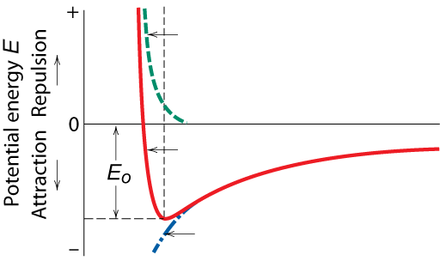
Ionic Bonding
Energy – minimum energy most stable
  Energy balance of attractive and repulsive terms
A
B
E_{N} = E_{A} + E_{R} =
-
+
r
r
n
Repulsive energy E_{R}
Interatomic separation r
Net energy E_{N}
Attractive energy E_{A}

Slide 35
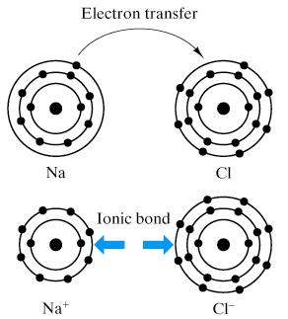

Slide 36
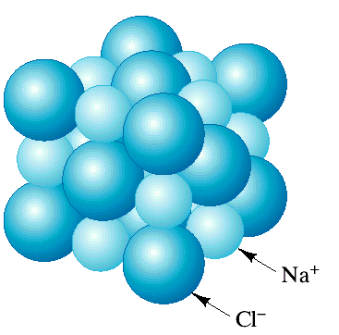
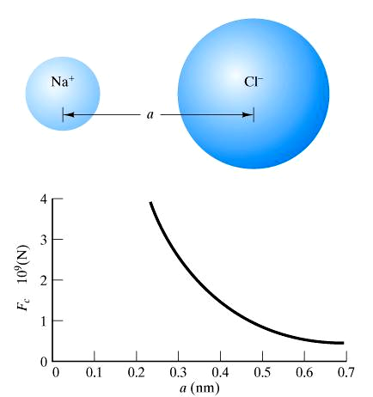
Ionic Bonding
e⁻
Na
Cl
Na⁺
Cl⁻
Electron transfer reduces energy of the system
Na shrinks and Cl expands

Slide 37
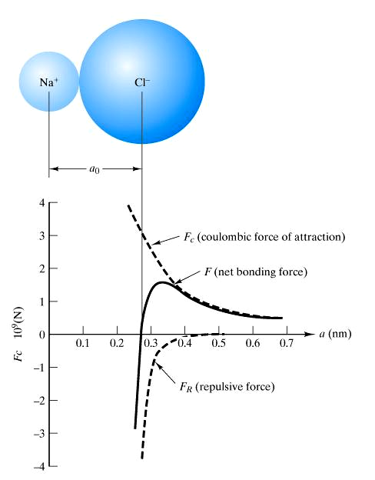
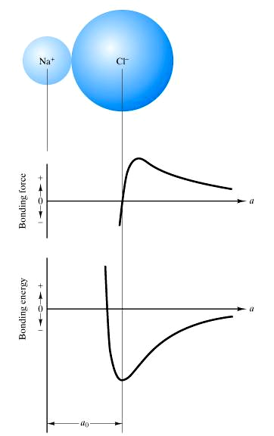
Ionic bonds: very strong, nondirectional bonds

Slide 38
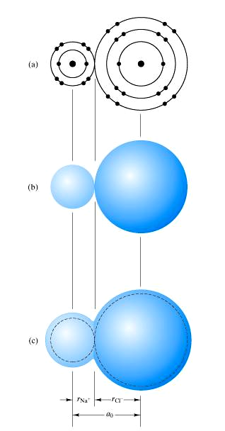
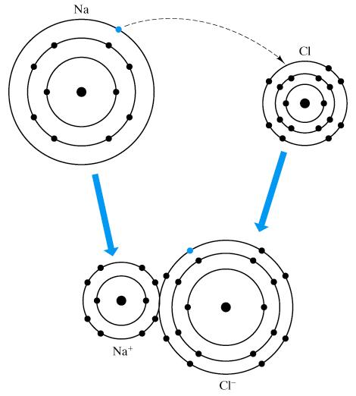

Slide 39
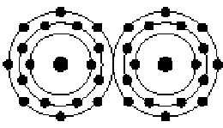
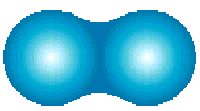
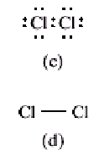
Covalent Bonding
Electrons shared between the atoms.
Valence electrons spend more time between nuclei than outside → bonding.
Covalent bonds- HIGHLY directional in direction
of greatest orbital overlap
Example: Cl₂ molecule. Z_{Cl} =17 (1S² 2S² 2P⁶ 3S² 3P⁵)
N’ = 7, 8 - N’ = 1 → can form only one covalent bond

Slide 40
共價鍵：緊鄰原子共享電子之原子間鍵結
diamond, Si, Ge, GaAs, InSb, SiC, H₂, Cl₂, F₂, CH₄, H₂O, HNO₃, HF
特定方向, 8-N’ 鍵

Slide 41
Covalent Bonding
similar electronegativity ∴ share electrons
bonds determined by valence – s & p orbitals dominate bonding
Example: CH₄
shared electrons
C: has 4 valence e⁻,
needs 4 more
H
from carbon atom
CH
4
H: has 1 valence e⁻,
needs 1 more
H
C
H
shared electrons
H
from hydrogen
atoms

Slide 42
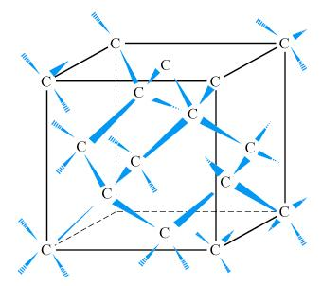
diamond:
(each C atom has four covalent bonds with four other carbon atoms)

Slide 43
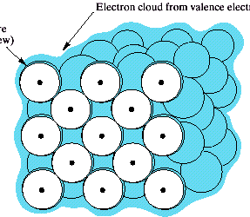
Metallic Bonding
Valence electrons are detached from atoms
Spread in an 'electron sea'
that "glues" the “ions” together
Metallic bond is non-directional → atoms pack closely
Electron cloud from valence electrons
ion core

Slide 44
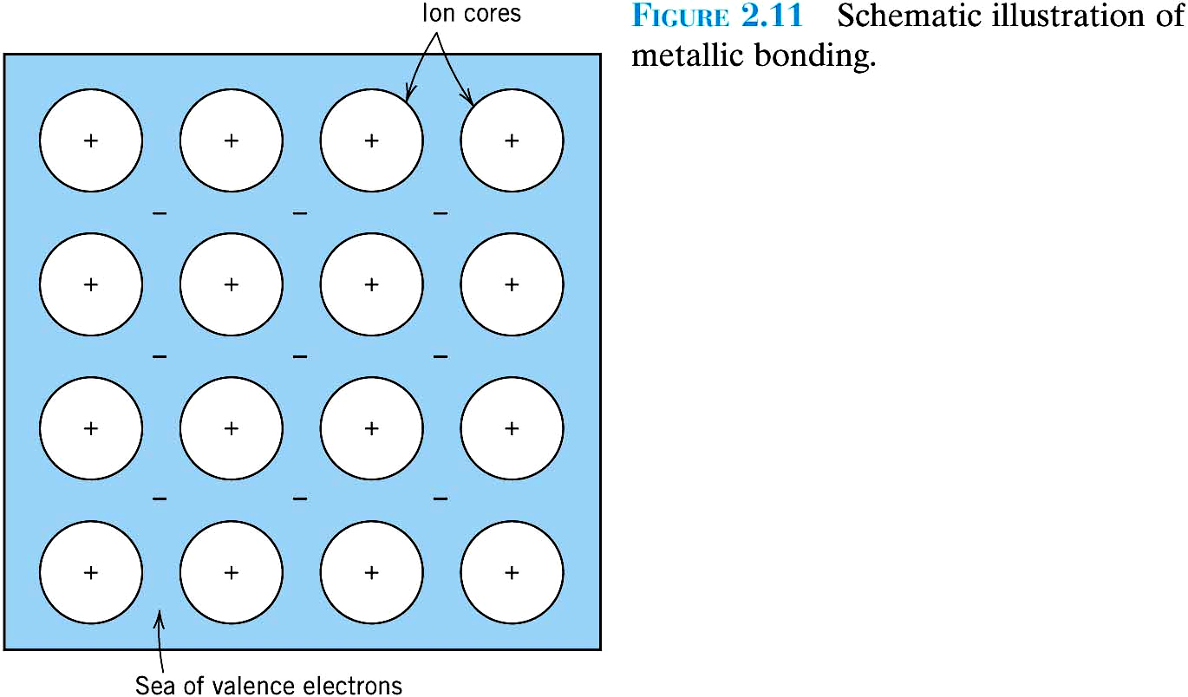

Slide 45
金屬鍵：在金屬固體中所有原子共享不限於局部價電子之原子間鍵
電子海, 電子雲
離子核心. 不具方向性
0.7 eV/atom for Hg, 8.8 eV/atom for W
良導體，延展性好

Slide 46
Secondary Bonding
Secondary = physical bond
(as opposite to chemical bond that involves e⁻ transfer) Interaction of dipoles
Is weak, ~0.1 eV/atom or ~10 kJ/mol.

Slide 47
SECONDARY BONDING
Arises from interaction between dipoles
• Fluctuating dipoles
asymmetric electron
ex: liquid H
2
clouds
H
2
H
2
+
-
+
-
H
H
H
H
secondary
secondary
bonding
bonding
• Permanent dipoles-molecule induced
-general case:
+
-
secondary
+
-
bonding
-ex: liquid HCl
H
Cl
secondary
H
Cl
bonding
-ex: polymer
secondary bonding
secondary bonding

Slide 48
_
_
+
+
-two dipoles attract
Permanent dipoles exist in some molecules
polar molecules: e.g. HCl, H₂O
Due to asymmetry of positive and negative regions Strongest among secondary bonds.
Polar molecule induces a dipole in adjacent non-polar molecule.
Attraction between the permanent and induced dipoles.
Fluctuations of electron density distribution in one atom A is felt by the electrons of an adjacent atom:
Mutual dipoles induced (van der Waals)
This bond is the weakest (He-Ne, H₂ - H₂).

Slide 49
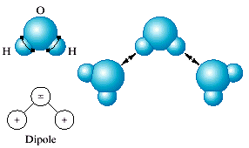
“Hydrogen bond” – secondary bond formed between two permanent dipoles in adjacent water molecules.
Example: hydrogen bond in water. The H end of the molecule is positively charged and can bond to the negative side of another H₂O molecule (the O side of the H₂O dipole)
O
H
H
-
+
+
Dipole

Slide 50
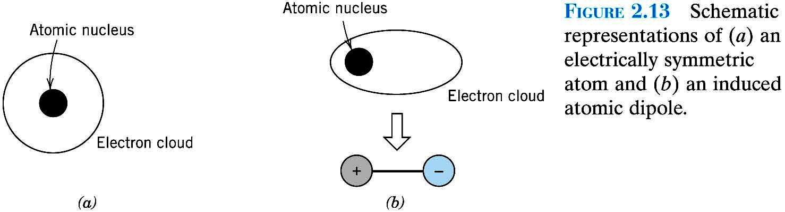
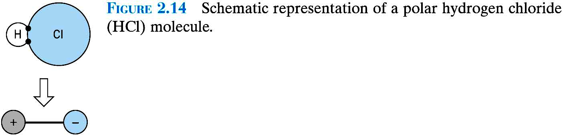

Slide 51
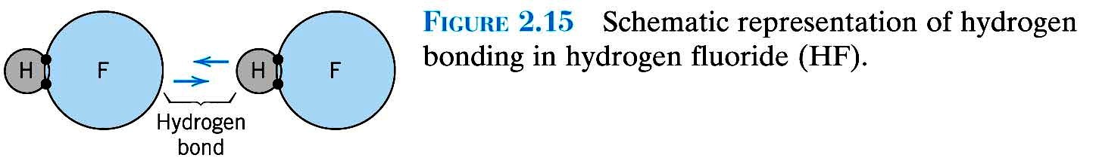
Molecules: Primary bonds inside, secondary bonds among each other

Slide 52
Summary: Bonding
Type
Bond Energy
Comments
Ionic
Large!
Nondirectional (ceramics)
Covalent
Variable
Directional
(semiconductors, ceramics
polymer chains)
large-Diamond
small-Bismuth
Metallic
Variable
large-Tungsten
Nondirectional (metals)
small-Mercury
Secondary
smallest
Directional
inter-chain (polymer)
inter-molecular

Slide 53
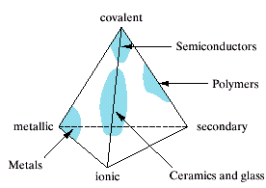
Examples of bonding in Materials:
Metals: Metallic
Ceramics: Ionic / Covalent
Polymers: Covalent and Secondary
Semiconductors: Covalent or Covalent / Ionic

Slide 54
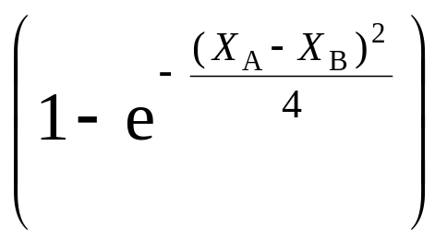
Ionic-Covalent Mixed Bonding
% ionic character =
x
(
100
%)
where X_{A} & X_{B} are Pauling electronegativities

Slide 55
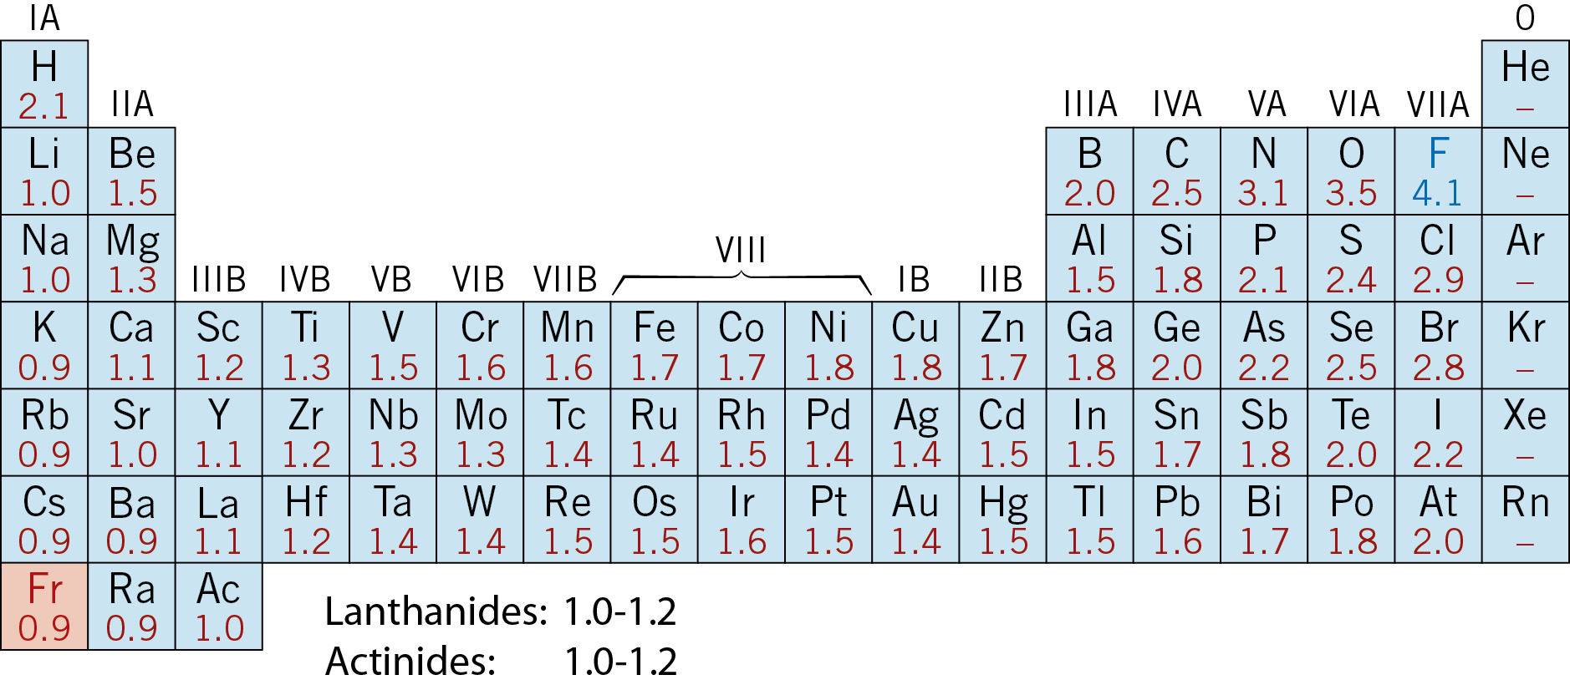
Electronegativity
• Ranges from 0.9 to 4.1,
• Large values: tendency to acquire electrons.
Smaller electronegativity
Larger electronegativity

Slide 56
Summary: Primary Bonds
Ceramics
Large bond energy
large T_{m}
large E
(Ionic & covalent bonding):
Metals
Variable bond energy
moderate T_{m}
moderate E
(Metallic bonding):
Polymers
Directional Properties
Secondary bonding dominates
small T_{m}
small E
(Covalent & Secondary):
secondary bonding

Slide 57
